Slide 1

Predictive Modeling
By: Suzy Adel

Slide 2
Intro

Slide 3
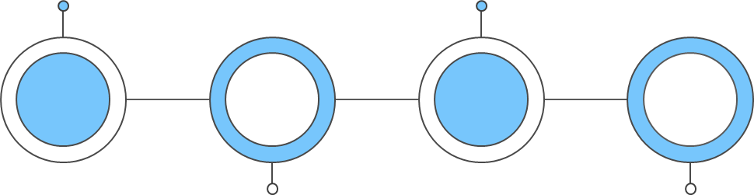
Task 2: Predictive Modeling for Disease Diagnosis
Problem Statement
Task
1
2
3
4
Objective
Outcome

Slide 4
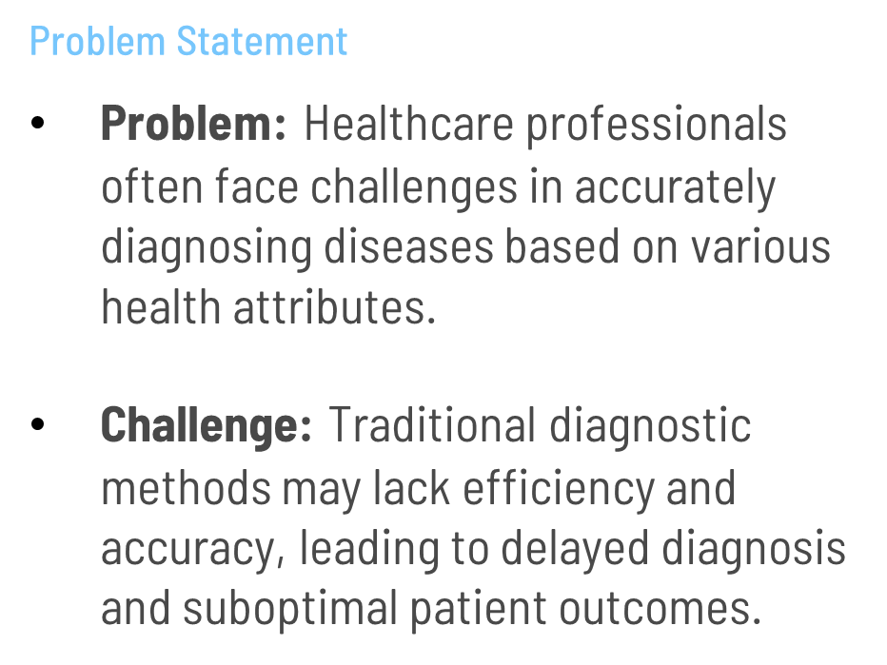
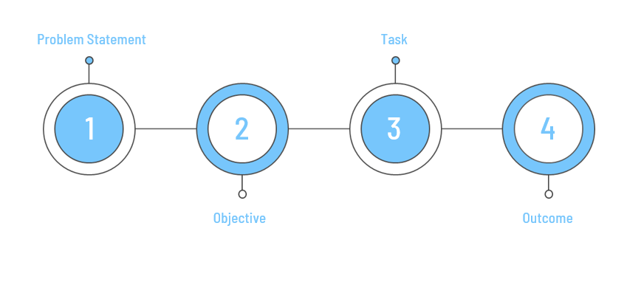
Task 2: Predictive Modeling for Disease Diagnosis
Outcome

Slide 5
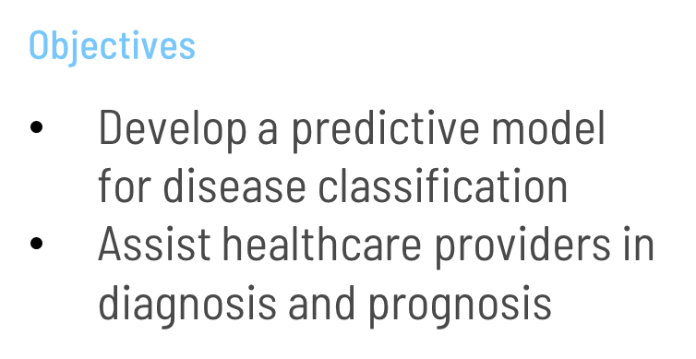
Task 2: Predictive Modeling for Disease Diagnosis

Slide 6
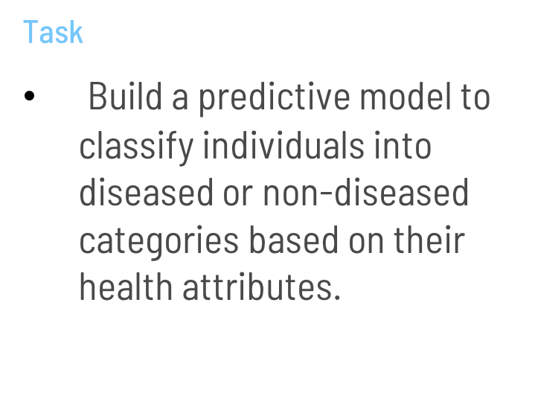
Task 2: Predictive Modeling for Disease Diagnosis
Outcome

Slide 7
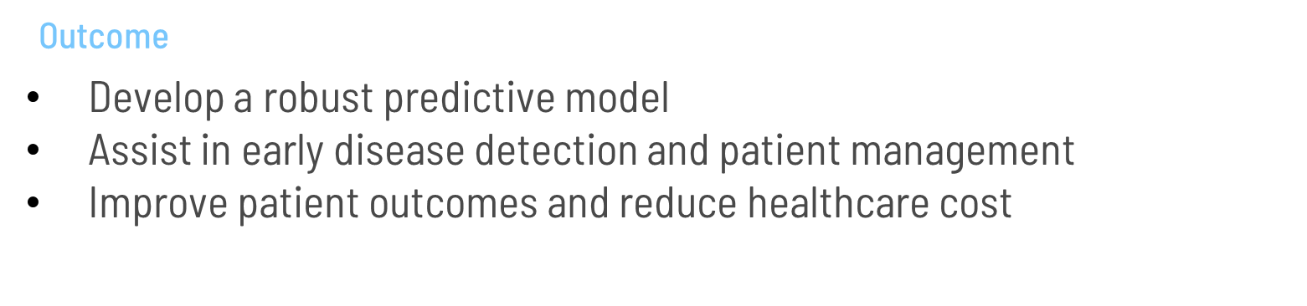
Task 2: Predictive Modeling for Disease Diagnosis

Slide 8


Classification Models
01
02
Linear Regression
Logistic Regression
Predicts continuous outcomes using a linear relationship.
Used for binary classification problems.
Yes/No , 0/1..

Slide 9


Steps In Predictive Analysis
1
2
3
4
Data Exploration
examining and understanding the dataset to uncover patterns, and identify the structure of the data.
Data cleaning
preparing the dataset for modeling by handling missing values, correcting errors, and ensuring consistency.
Modeling
selecting and training machine learning algorithms on the prepared dataset to develop a predictive model.
Performance analysis
assessing the predictive model's effectiveness and making necessary adjustments to improve its accuracy and reliability.

Slide 10

Code Attempts

Slide 11
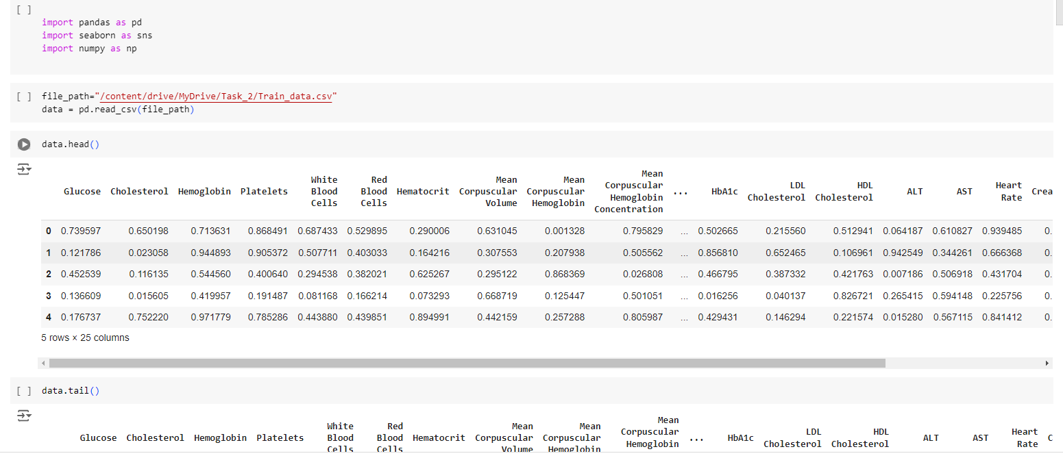
1
Trying out the simplest Regression “linear regression”
This is to see the first/last 5 rows of data to check the types and analyze it

Slide 12
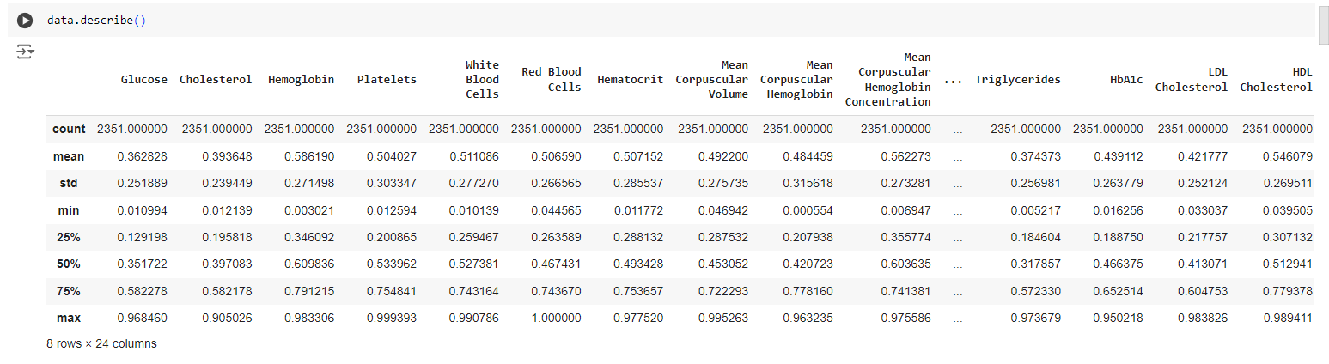
1
This is to calculate data’s mean/avg values to replace any zero values or any missing data

Slide 13
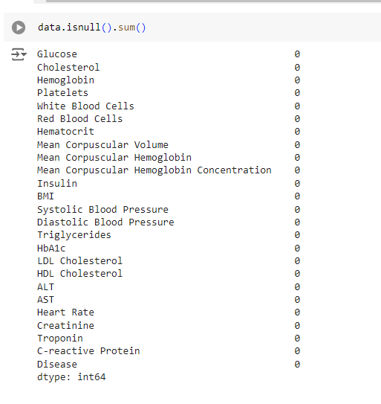
1
However the training data results had 0 null values, meaning no need to replace them

Slide 14
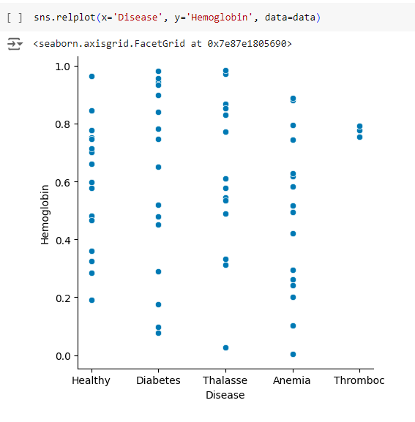
1
As soon as I visualized the input I realized that the data is not continuous and it have no linear relationship

Slide 15
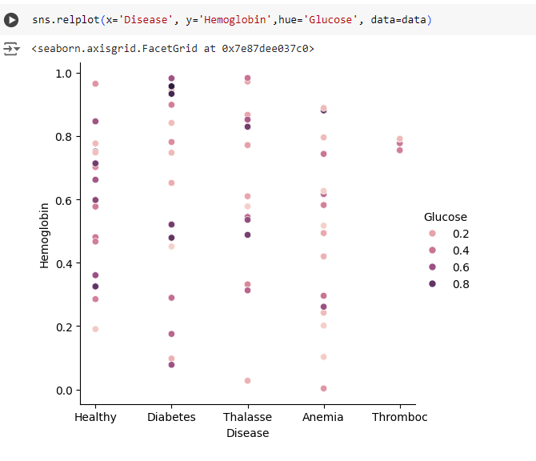
1
Even the 2 classes have no linear relationship therefore we should use another approach

Slide 16
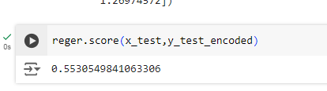
Linear Regression Performance
Troubleshoot:
Solutions for attempt 2:
This wasn’t the best model to use since the data is not continues
The data is not cleaned causing duplicates to decrease its accuracy
No direct relationships between 2 variables (independent/dependent)
Try out different regression model
Try to clean duplicates
Choose a better cohesive model

Slide 17

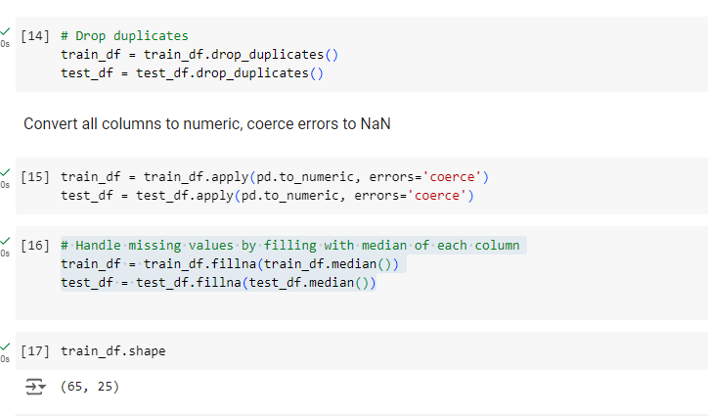
2
Logistic Regression model with attempts to solve the troubleshoots
The data became too small increasing the risk to become untrained or inaccurate results

Slide 18
2
The data became too small increasing the risk to become untrained or inaccurate results

Slide 19
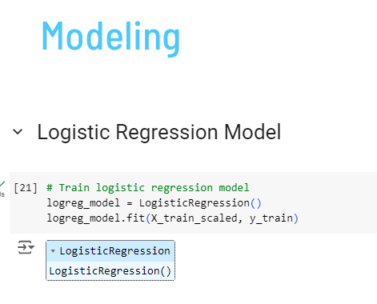
2

Slide 20
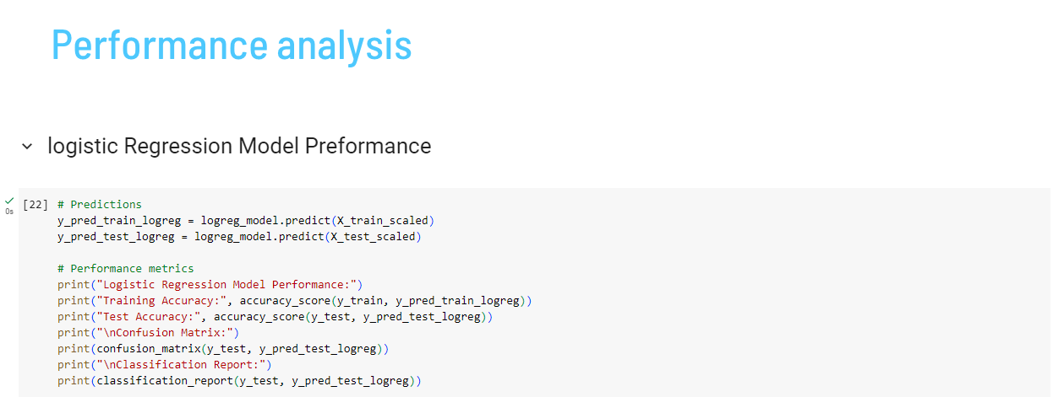
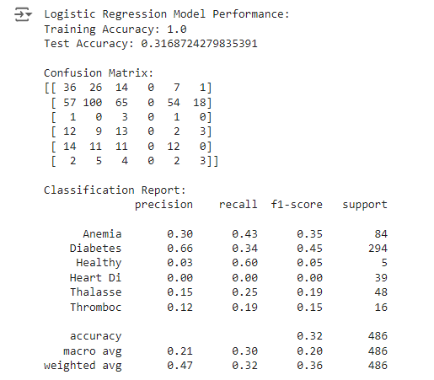
2
This is due to few data overfitting and inaccuracies of the regression model

Slide 21
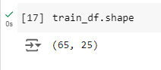
Logistic Regression Performance
Troubleshoot:
Solutions for attempt 3:
This is a better model however, it has overfitting and doesn’t handle the missing and duplicated data correctly
The data is TOO cleaned causing very few data ,not allowing it to train properly
Remove the manual deleting data , and use an internal integrated model
Since there is no zero data don't over write it and fi the original data with minimal changes

Slide 22
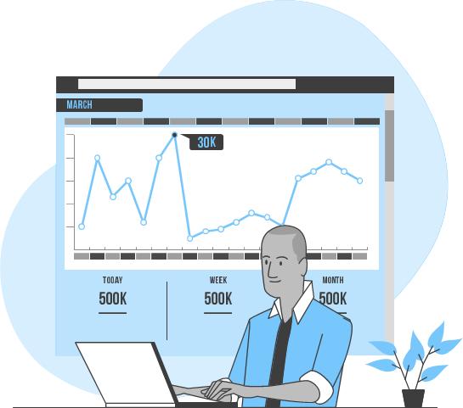
Final Code
XGBoost Regression model

Slide 23
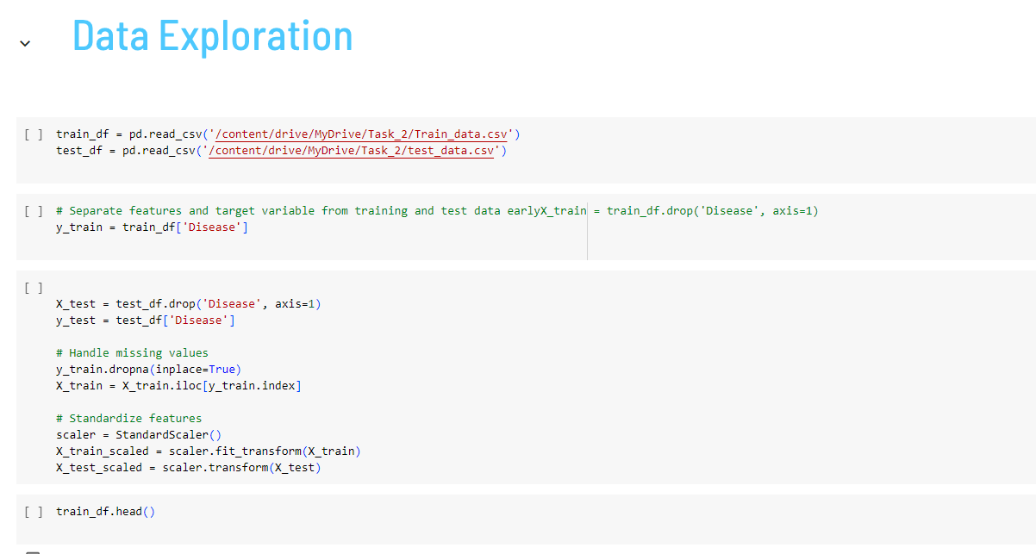
Trying to examine and understand the dataset to uncover patterns, and identify the structure of the data set .

Slide 24
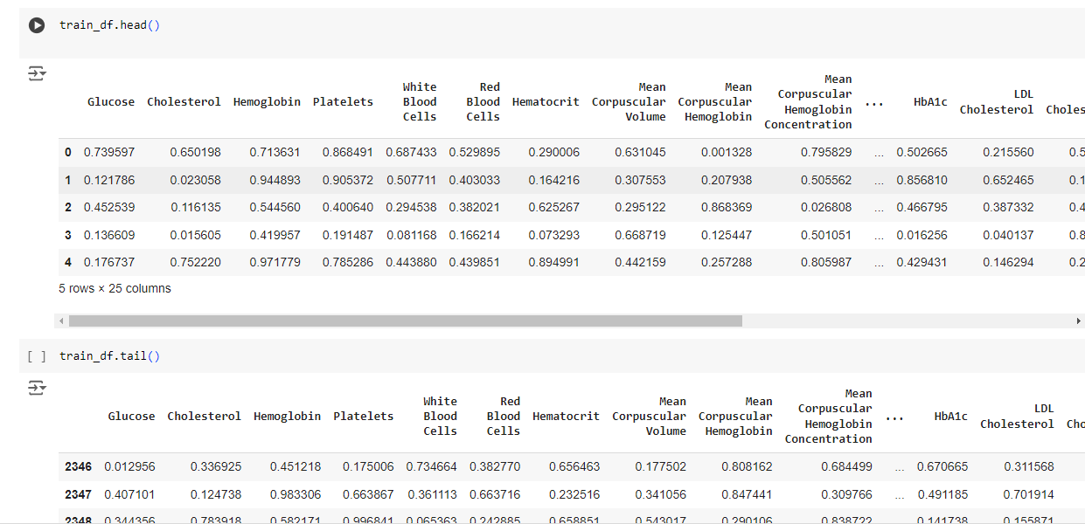

Slide 25
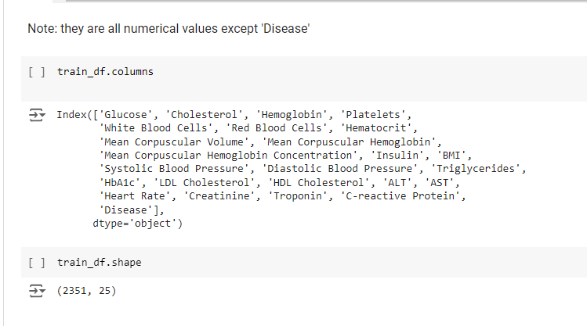
Class names
Rows x columns

Slide 26
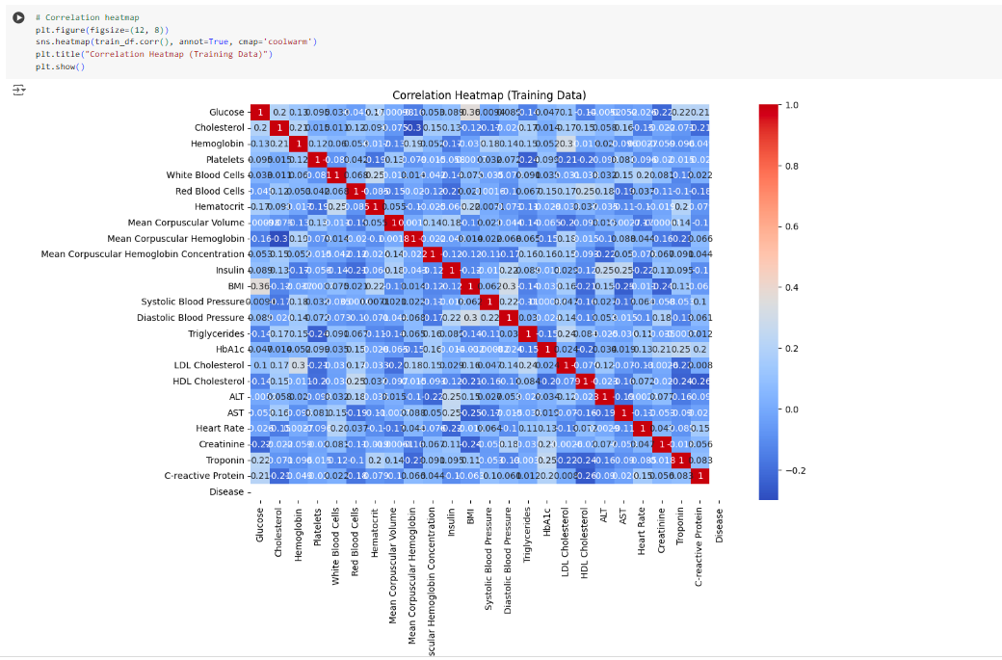
Visualization

Slide 27
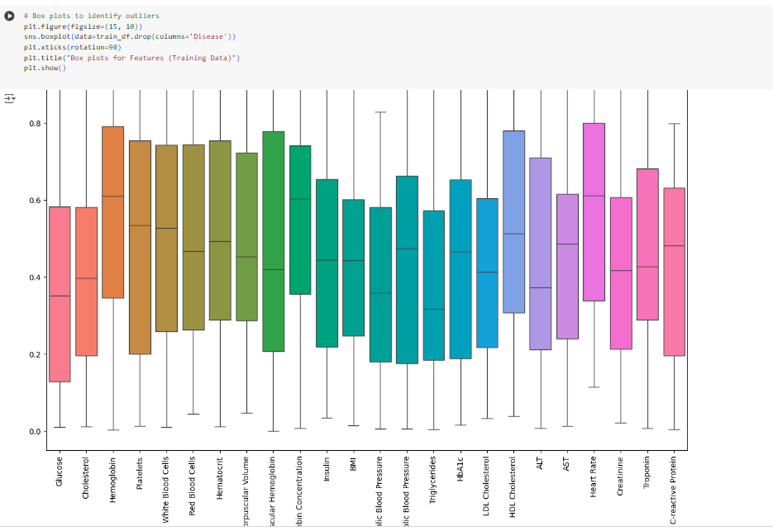

Slide 28
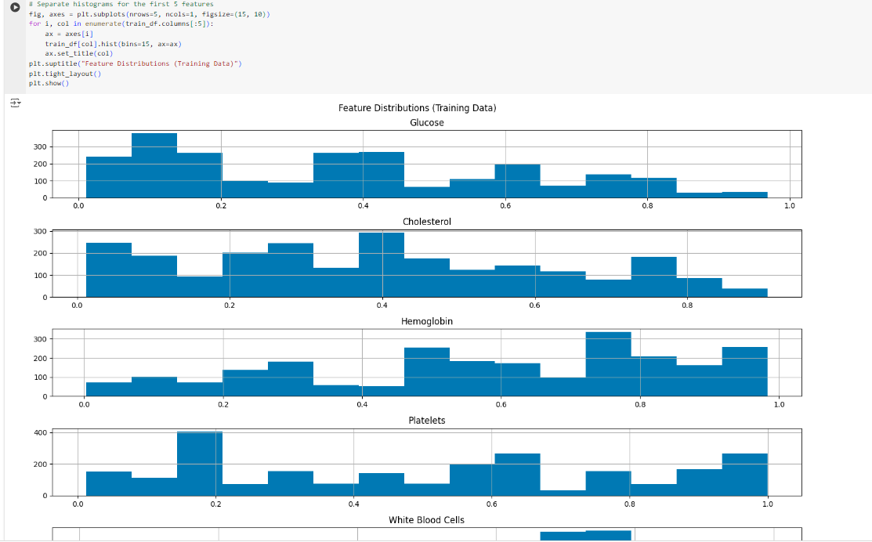

Slide 29
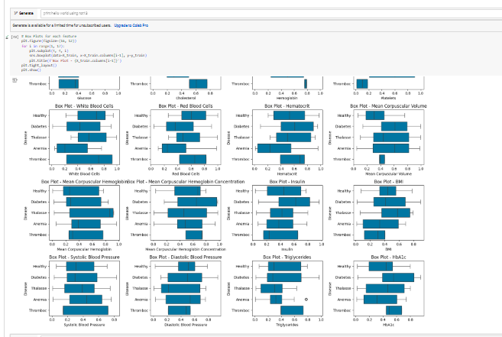
Creating correlation heatmaps, box plots, and feature distribution plots before modeling helped you grasp the relationships between features, identify potential outliers, and understand feature distributions.

Slide 30
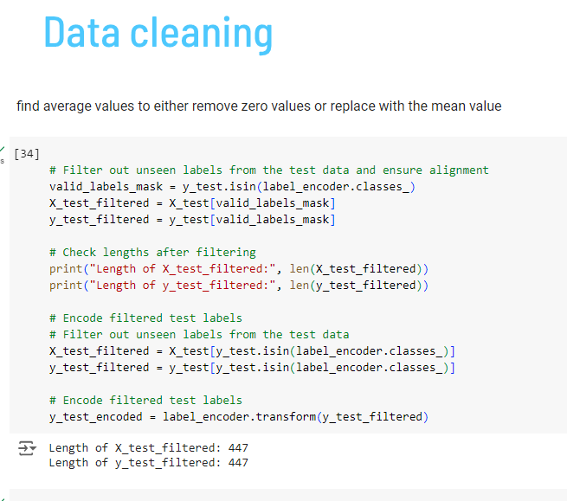
Ensuring that all lengths match as expected before proceeding with model training and prediction.

Slide 31
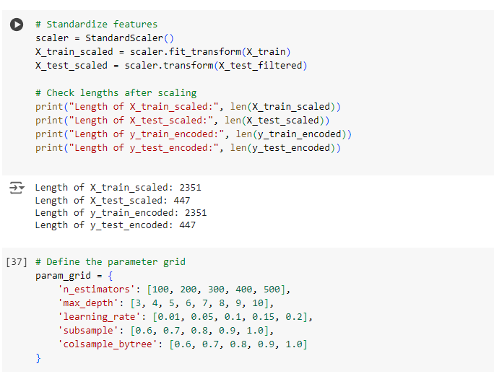

Slide 32
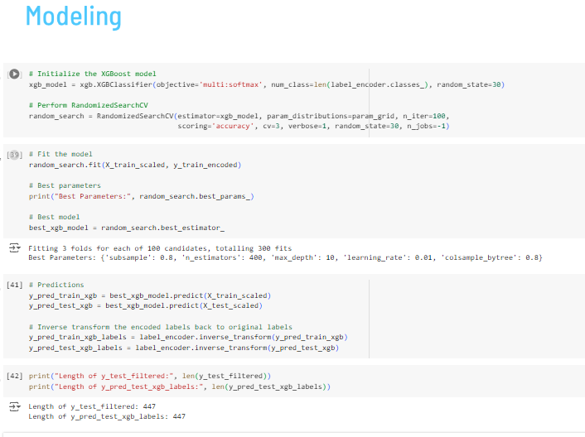
XGBoost offers superior performance, speed, and efficiency with built-in handling for missing data and regularization to prevent overfitting, making it highly effective for complex machine learning tasks..

Slide 33
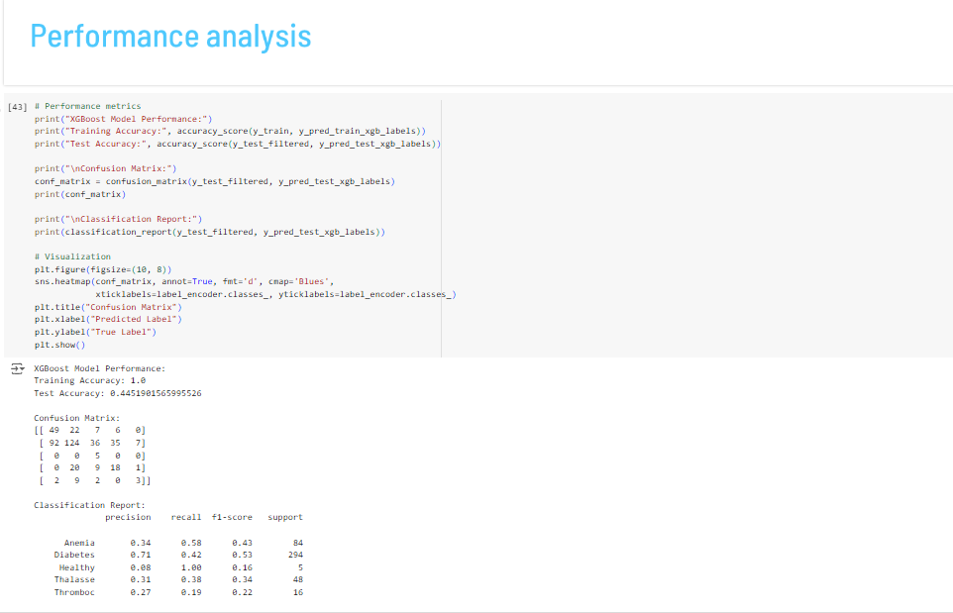

Slide 34
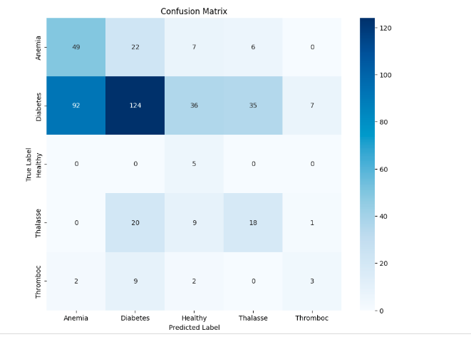
Visualization of the confusion matrix and classification reports after model training provided insights into where the model was performing well and where it was struggling.

Slide 35
Finale

Slide 36


Things I learned
Hyperparameter tunning significance
Importance of data preprocessing
Visualization aids in understandingdata and model behaviour
If certain accurate data has bigger weight than polar results it enhances accruacy
When certain missleading data is removed from the start it prevents overfitting
Helps give us an idea where the expected output and judge the outcome

Slide 37
Thanks!
Do you have any questions?
suzyadel37@gmail.com
+201204407191
https://www.mentorness.com/
Please keep this slide for attribution

